Slide 1
John M. Sexton Title l Annual Meeting
2024-25

Slide 2
All About Title l
Title I is the largest federal assistance program for our nation’s schools.
The program serves 99 schools in Pinellas County including eligible students in 39 non-public schools.
The Title l goal is that every student achieves high levels of academic proficiency.
Notes:
Highlight the Title l Program here in Pinellas County.

Slide 3
John M. Sexton Elementary School
August 10, 2024
11:00
John M. Sexton Classroom
Tony Pleshe, Principal
2024-25 Title l Annual Parent Meeting
Notes:
Evidence: Upload completed presentation and recorded feedback as part of the evidence to support the Annual Meeting Materials. Do not forget the sign-in sheets, and survey/feedback that you receive throughout the meeting.

Slide 4
Title I Funding Process
2. Florida Department of Education
1. Federal Government
4. John M. Sexton
3. Pinellas County Schools
Notes:
The Florida Department of Education receives funds from the federal government. Districts receive Title I funds from Department of Education, and the school district distributes these funds to schools based on the percentage of children eligible for free/reduced price lunch; however, students do not have to be from low-income families to receive help.

Slide 5
Title l Supplemental Resources
John M. Sexton employs several professionals to help assist in meeting the needs of our students. Our budget is used to pay Hourly Teachers, Academic Coaches and purchase classroom supplies.
Notes:
Definition: provided in addition to what is already present or available to complete or enhance it extra academic support and learning opportunities for economically disadvantaged students.

Slide 7
Let’s Celebrate!
Our school earned a B according the state grading system.
Through the use of Title I funds, we were able to use hourly teachers and coaches to enhance the student learning.
Notes:
Based on the FAST data and school grades, there is a lot to celebrate!!
How did your Title I Resources support or enhance the work that you were able to get done?

Slide 8
Title I Programs Provide Supplemental Support
Supplemental Resource | Positive Impact
Additional Personnel | Hourly Teacher MTSS Coach
Summer Training | Kindergarten and 3rd grade teachers attended an educational conference in Orlando.
Extended Learning Opportunities (before and/or after school programs) | Students are offered additional afterschool Tutoring and enrichment programs
Parent and Family Engagement Resources and Training Workshops | Resources like the student agendas are purchased with Title I All Academic Nights are funded through Title I
Supplemental teaching materials, equipment, and technology | A portion of the allocation is used to purchase classroom supplies
Notes:
Use additional slides if necessary. This is where you want to really highlight Title I funding and how it positively impacts your scholars! Additional supplemental personnel (add specific positions)
If there are connections that they can make, they call it out!

Slide 9
Title I Schoolwide Planning and Input
First
Second
Last
Seek Input from school, family, and community members determine how Title I funds are used based on a needs assessment.
Please attend online or in-person meetings/trainings and complete surveys to provide input on Title I funding.
All Title I schools must document that parents are involved in the schoolwide planning process.
Notes:
Evidence for input – input from school can be a survey or notes, which include quotes related to what was shared as feedback AND how this input will be used to inform the PFEP and future engagement activities.
Evidence of Attendance – please include attendance of DIVERSE stakeholder group/s.

Slide 10
Title I Schoolwide Budget
John M. Sexton is provided 89,750 to pay for supplemental resources and programs for increased student achievement.
Personnel
Professional Development
Curriculum Development and Coordination
Technology Support
Supplemental Instructional Materials and Resources

Slide 11
A+ School’s Title I Parent & Family Engagement 2023-24 Budget
Total Allocation - $5,700
Teachers Stipends to Provide Parent Training - $700
Family Engagement Resources - $5,000
Notes:
SAMPLE ONLY - Delete Slide
Highlight your budget and resources and how they will be used to support family engagement.

Slide 12
Parent’s Right to Know
As a parent of a student attending a Pinellas County School Public School, you have the right to…
Be
Be provided information on your child’s level of achievement on assessments in Reading/Language Arts, Writing, Mathematics, and Science.
Request and receive information on the qualifications of your child’s teacher and supplemental personnel working with your child.
Be
Be notified of non-highly qualified or out-of-field teachers at the school.
Be
Be informed if your child is taught by a non-highly qualified teacher for four or more consecutive weeks.

Slide 13
Working Together for Student Success
School
School Improvement Plan (SIP)
Title
Title I Schoolwide Plan
Parent
Parent and Family Engagement Plan
School
School-Parent-Student Compact
Title l is now included as a part of the School Improvement Plan
Notes:
As a Title I parent you have the right to be involved in the development of the following plans and documents for our school which can be found on our website (insert website) to view as well as in the Parent Station located (insert location here).
Our school’s Title I Parent Station is located (insert location or photo of Title I Parent Station (front office and on the webpage). Please include photo as part of the evidence monitoring.
You will find a copy of our School Improvement Plan, Title I Schoolwide Plan, School’s PFEP, the School District’s PFEP, Parent’s Right to Know Memo, Upcoming Events, Compact, (insert other documents at your station)
School Improvement Plan (SIP)
Parent and Family Engagement Plan
Title I Schoolwide Plan
School-Parent-Student Compact

Slide 14
Parent-School-Student Compact
The purpose of the compact is to foster student achievement. By signing the Parent-School-Student Compact, (Insert name of school here), teachers, staff, parents and students agree to work together to share the responsibility of helping students meet or exceed state, district and school academic goals.
The Parent-School-Student Compact is updated every year to include parent, student, teacher, and staff input. Parent, student, teacher and staff comments are welcome at any time during the year.
Please review and sign your child’s Compact.
Our goal is to receive 100% signed compacts!
Notes:
At the elementary level, school compacts are used as a progress monitoring tool through the year during parent teacher conferences.

Slide 15
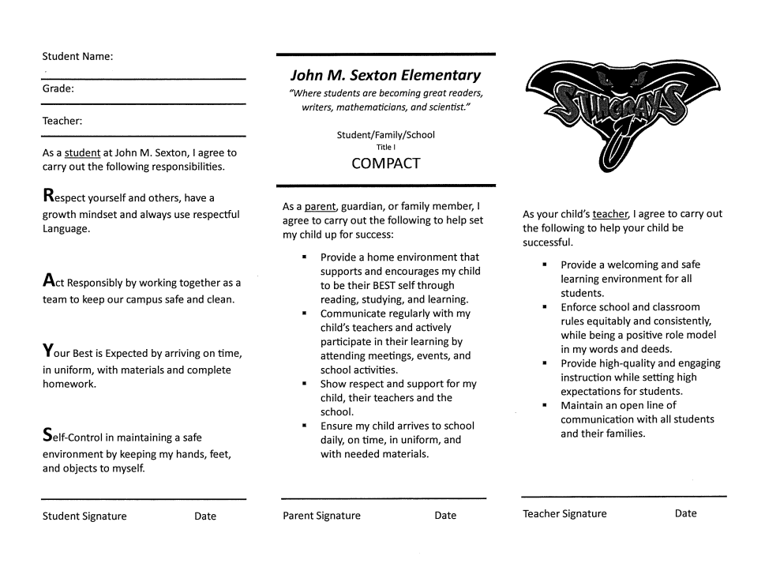
School Compact
Notes:
Please insert the an example of your updated school compact. Highlight any things that unique to your school’s compact.

Slide 16
Parent and Family Engagement Plan (PFEP)
The PFEP Sections include information about the following:
Parent trainings to increase student achievement
Staff trainings for engaging parents
Communication methods between home and school
Flexible meeting times
Accessibility for parents
Coordinating with other Federal Programs
To access the full LEA PFEP, please visit
www.pcsb.org/titleone
Notes:
Provide information on the specific committees that parents can be involved. Include the purpose, date and time of meetings.
Explain the PFEP and its purpose.
Consider the evidence related Title I Crate, Sample of Evidence,

Slide 17
Florida Benchmark For Excellent Student Thinking Standards (B.E.S.T). You may read more information by visiting, www.fldoe.org.
Notes:
All curriculum, instruction and assessments are based on student-centered expectations.

Slide 18
School’s Curriculum
Florida Benchmark For Excellent Student Thinking Standards (B.E.S.T). form the framework of everything taught at school.
Core Curriculum (insert specifics)
Reading
Mathematics
Writing
Science
Civics
Notes:
This slide is optional if this will be discussed with classroom teacher
School’s Curriculum
Describe and explain the curriculum (Specific names of texts)

Slide 19
School Report Cards
School Grade and Overview
Population and Enrollment
Assessments – Academic Achievement, Growth, and Population
Assessments – English Language Learners
Graduation and Beyond
Educator Qualifications and Equity
Long-Term Goals and Interim Progress
Accelerated Course Enrollment
Per-Pupil Expenditures
National Data
Available online at https://edudata.fldoe.org/ or Front Office

Slide 20
If interested in being involved, join PTA and our School Advisory Council.
Meeting Time: 7:45 on the following dates
September 17 January 21 April 22
October 15 February 18 May 20
November 19 March 23
Notes:
Do you have a calendar of key events that are included in your PFEP.
Evidence – Consider this as evidence to include to support Family Engagement.

Slide 21
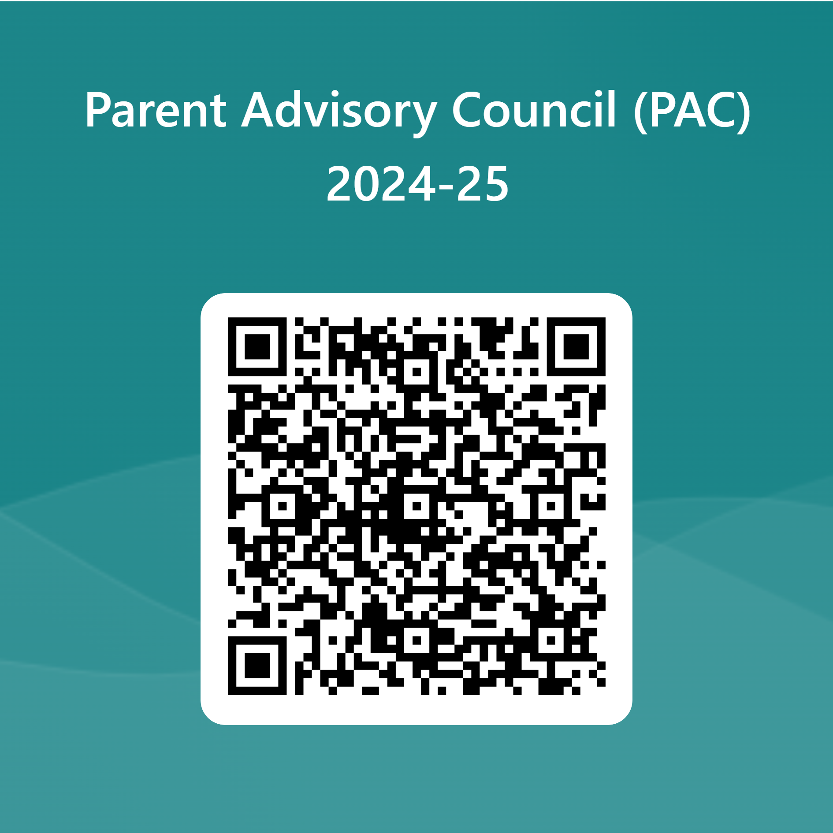
Parent Advisory Council (PAC)
The District has a Parent and Family Engagement Plan. The summary of the plan is in the Title I School & Family Partnership Overview.
You may access the full plan at www.pcsb.org/titleone
The Parent Advisory Council (PAC) is responsible for reviewing and revising the District PFEP.
PAC will meet virtually or in person with the district’s Title I staff.
Each school is committed to having at least one member representative in PAC.
PAC meets twice a year, if you are interested in representing our school please notify, Insert contact person
Notes:
Please add your PAC representative in slide and share with your Title I Specialist.
https://forms.office.com/r/r5daaMTENE\

Slide 22
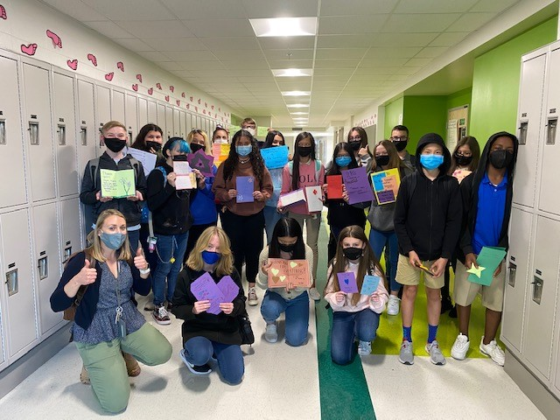
Additional Resources
Learning at Home Family Resources - https://www.pcsb.org/Page/32836
Volunteer in a Pinellas County School - https://www.pcsb.org/Page/459
Parent Academy POWER HOURS Webinars - https://www.pcsb.org/Page/26534
Partnerships - https://www.pcsb.org/Page/418

Slide 23
Thank you for your time!

